Slide 1


Slide 2
Using Universal Windows Platform Bridges
Bringing iOS/Android/Web/Classic/Silverlight apps to Windows platform
OLEKSANDR KRAKOVETSKYI
CEO DevRain Solutions, Windows Development MVP, Microsoft Regional Director, PhD., @msugvnua, Alex.Krakovetskiy@devrain.com

Slide 3
About
CEO DevRain Solutions
Microsoft MVP (Windows Development Platform, previously – ASP.NET/IIS)
Microsoft Regional Director
PhD in Computer Science (Data Analysis and Machine Learning)

Slide 4
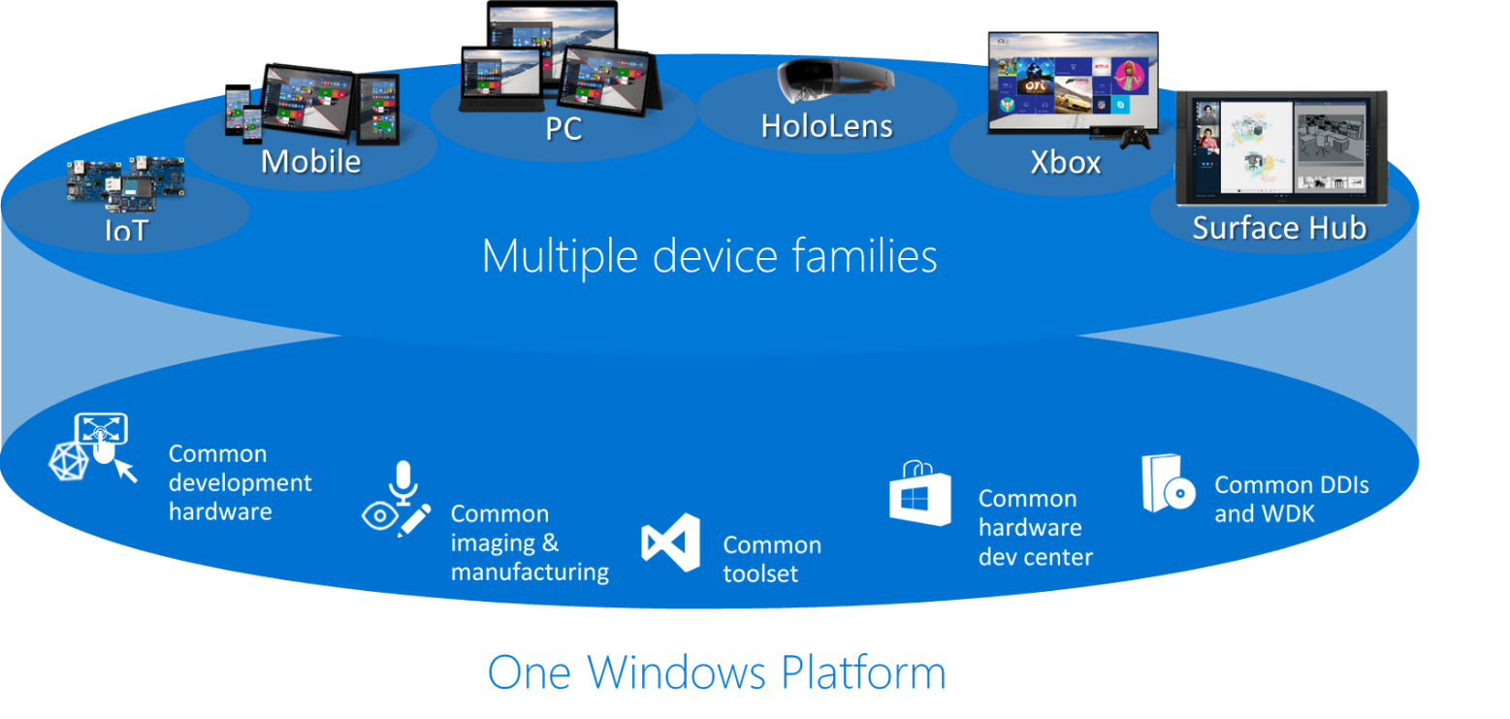
Universal Windows Platform

Slide 5

Universal Windows Platform
Wherever your code was born, you can bring it to Windows
Windows Platform
Web Platform
Universal Windows 8 Apps (C++/C#/JS)
Microsoft Edge HTML Engine
Universal Windows 10 Apps (C++/C#/JS)
Surface Hub
Desktop
Cordova Tooling (HTML/JS)
Project Centennial (Classic Apps)
Hosted Web Apps (HTML/JS)
Universal Windows Platform
IoT
Xbox
Middleware Platforms
Other Mobile Platforms
Middleware Partners (e.g., Xamarin)
Holographic
Mobile
Project Astoria (Java/C++)
Game Engine Partners (e.g., Unity)
Project Islandwood (Objective C/C++)

Slide 6
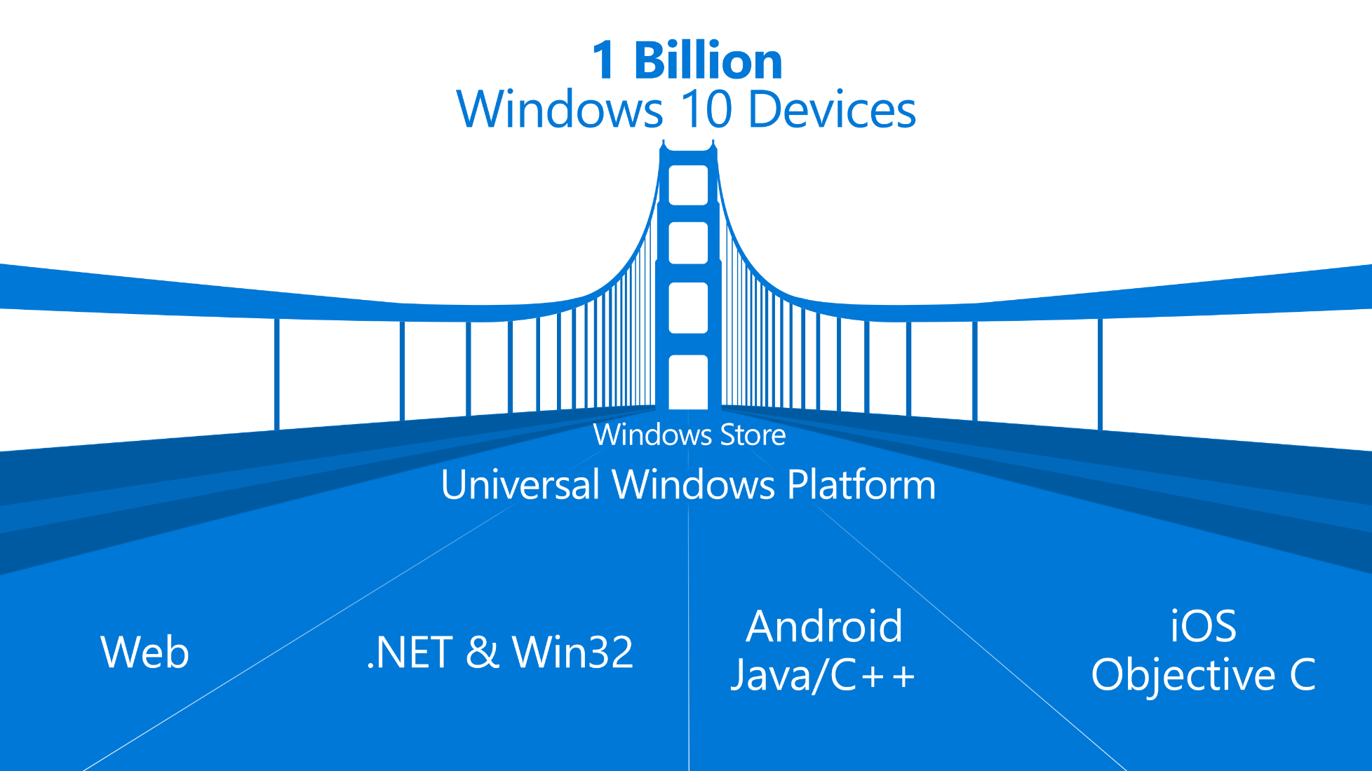

Slide 7
Universal Windows Platform Bridges
Windows Bridge for Android (”Project Astoria”) will enable you to build apps using Android code to target Windows 10 phones without having to leave your Android IDE.
Windows Bridge for iOS (”Project Islandwood”) will enable you to build a universal Windows app from within Visual Studio 2015 using your existing Objective-C code.
Windows Bridge for Classic Windows apps (”Project Centennial”) will make it possible to package and publish your current .NET and Win32-based Windows applications to the Windows Store, providing a new way of distributing and monetizing your application on Windows PCs.
Windows Bridge for web (”Project Westminster”). Windows 10 will make it easy for you to create a Windows app that packages your website for publishing to the Store. Once installed, your website can update and call Windows APIs from JavaScript, creating a more engaging user experience.
Bridge for bringing Silverlight apps to the UWP (Mobilize.Net)

Slide 8

Windows Bridge for Android («Project Astoria»)
The goal is to allow apps to be ported with as minimum code changes as possible, desirably none
The UI is converted to a native Windows one, but there are limitations on what can be done.
Porting works by redirecting Android OS calls to their corresponding Windows operations, without introducing any intermediary VM or runtime. This is done to avoid unnecessary CPU consumption which is important on mobile devices.
Google Play services calls - Ads, Analytics, In-app purchases and Notifications - are automatically redirected to corresponding Windows services without source code change. Bing Maps is used instead of Google Maps. Calls to Android device sensors, buttons or features, such as Contacts, Share, keyboard, are also mapped to Windows ones.
Windows specific code, such as Live Tiles, is added using Java.

Slide 9
Windows Bridge for Android («Project Astoria») Status
Microsoft officially acknowledged the company is dropping plans for its Android bridge.

Slide 10

Windows Bridge for iOS (“Project Islandwood”)
Windows Bridge for iOS (also referred to as WinObjC) is a Microsoft open source project that provides an Objective-C development environment for Visual Studio/Windows. In addition, WinObjC provides support for iOS API compatibility.
With the Windows Bridge for iOS you’ll be able to:
Import Xcode® projects into Visual Studio
Make minimal changes to your iOS/Objective-C code to build a Windows app
Build and debug your Objective-C code from Visual Studio
Take advantage of great Windows services
Extend your app to take advantage of Universal Windows Platform features

Slide 11
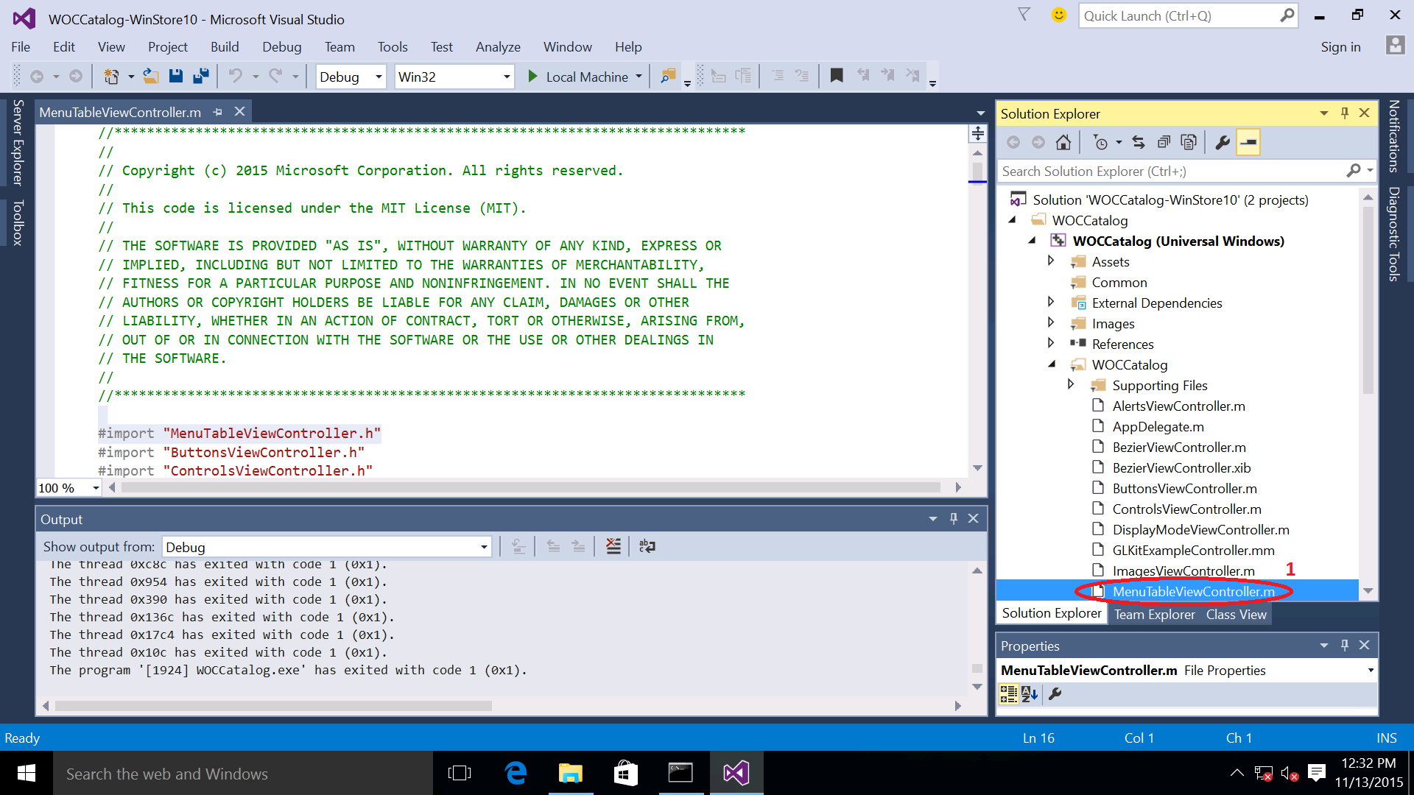
Windows Bridge for iOS
Download The Windows Bridge for iOS SDK.
Install objc-syntax-highlighting.vsix.
Locate the Xcode project and run vsimporter tool from the console which creates a Visual Studio solution for the Xcode project.
Profit!

Slide 12
Windows Bridge for iOS Status
Windows Bridge for iOS was released to GitHub as an open source project in August 2015 and updated frequently.
https://github.com/Microsoft/WinObjC/

Slide 13
Project Centennial
Make classic Windows apps -Win32, .NET, COM- run on the Universal Platform.
There are ~16M classic apps that could be ported with Centennial.
Project Centennial does not change anything in the code, it simply does some tricks to make app packaging and deployment run properly on UWP.
The Converter analyzes an MSI file, discovers and records what the app is doing during installation, what resources installs, what modifications it performs, etc. Then, an AppX is generated, including live tiles, which developers can test and load to the Store.
More details can be found by watching this Build 2015 session.

Slide 14
Project Centennial Status
Early iteration of the tools will be released soon, and then the program and support will be expanded to a broader range of developers.

Slide 15

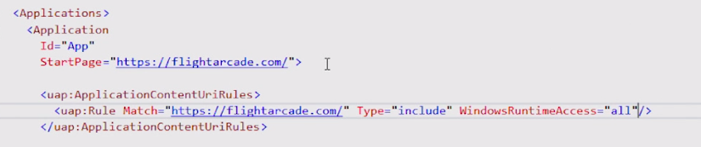
Project Westminster (Hosted Web Apps)
The Windows Bridge for web apps makes it easy to publish your responsive web app to the Windows Store as a Universal Windows Platform (UWP) app, while reusing your existing code and workflow.
Easily scale your responsive web app to different devices.
Interact with native Windows APIs from JavaScript running on your website.
Integrate with Cortana voice commands.
Debug your app with Microsoft Edge F12 Developer Tools.
Track status, ratings, and reviews, see analytics, and get paid for all of your Windows app in the Windows Store.
Updates should be pushed to web-server not the app.

Slide 16
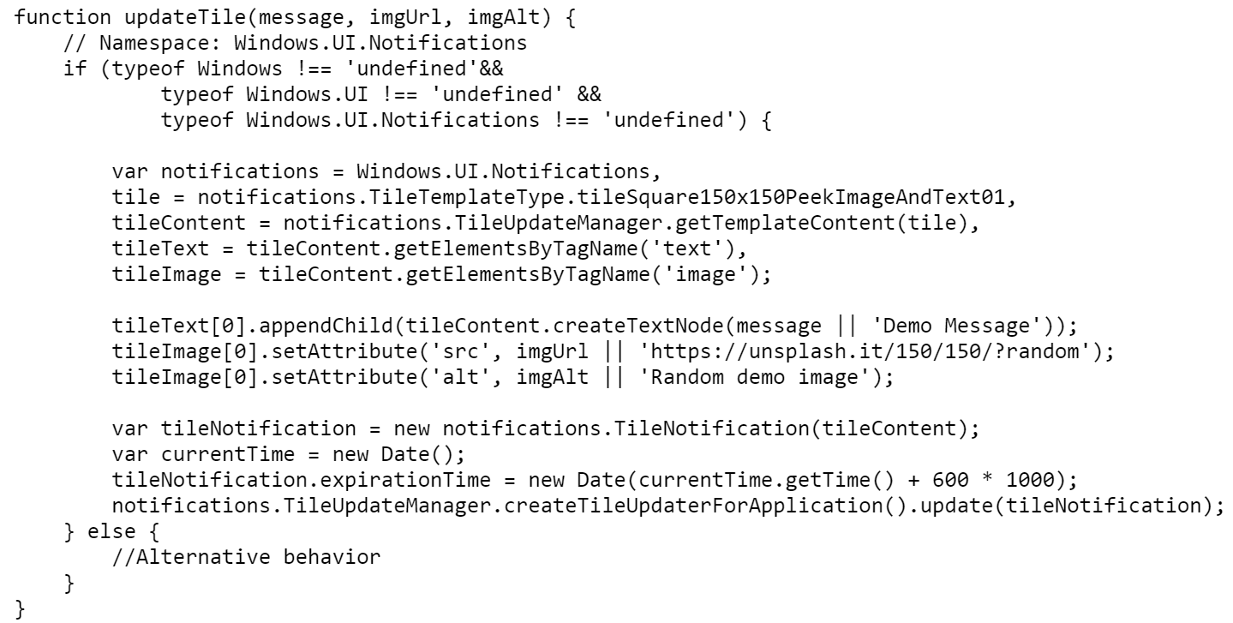
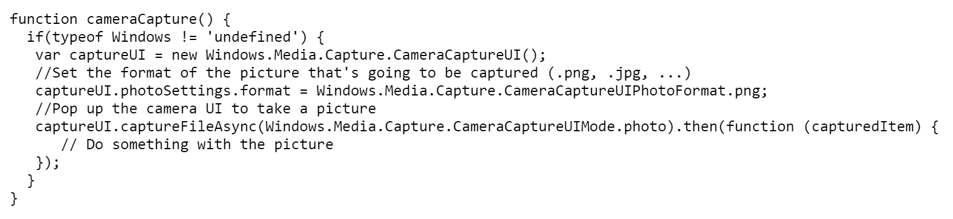
Project Westminster

Slide 17
Project Westminster Status
Shipped as part of the standard Windows 10 SDK in July and already seen adoption from companies such as Shazam and Yahoo.

Slide 18

Mobilize.NET
Bridge for bringing Silverlight apps to the Universal Windows Platform.
Get native C# code with no runtimes:
Convert Windows Silverlight Phone 8.x apps to Windows 10 apps.
Migrate workloads in 1/3 the time, 1/3 the normal cost.
Enables the top 80% of apps to be converted 80% of the way.
Includes mappings for top APIs and components.
Supports open source extensibility model - anyone can contribute mapping

Slide 19
Mobilize.NET
Converting an application
Project and manifest conversion Manifests of WPS 8.0 and 8.1 are very different from each other. The big difference is that WPS 8.0 manifests reference elements that come from different namespaces. Mobilize SL bridge saves developers a lot of work by converting both WPS manifest versions to the new UWP one.
API changes The first release includes 700 mappings, based on analysis that Microsoft did for Mobilize.Net of the most frequently used properties, methods, and events (PMEs). An additional 500 hundred mappings will be added in a couple of months. The initial 1200 available by year end should cover about 80% of all APIs used in the Silverlight Phone apps in the Windows Store.

Slide 20
The XAML below shows how Microsoft.Phone.Controls.Pivot property Tab and event MouseMove are renamed to Tapped and PointerMoved respectively:
<map:CodeMapPackage Type="Microsoft.Phone.Controls.Pivot">
<map:CodeMapPackage.Maps>
<map:CodeMap Kind="MemberAccess" MemberName="MouseMove">
<map:Rename NewName="PointerMoved" />
</map:CodeMap>
<map:CodeMap Kind="MemberAccess" MemberName="Tap">
<map:Rename NewName="Tapped" />
</map:CodeMap>
</map:CodeMapPackage.Maps>
</map:CodeMapPackage>

Slide 21
Mobilize.NET
XAML changes Mobilize SL bridge provides the same Mapping Mechanism in order to convert XAML objects from WPS to UWP.
Async and Await APIs Mobilize SL bridge automates the process by analyzing the code that is involved in the async call, propagating the async and await keywords through the appropriate code path. This propagation is heavily integrated with the Mapping Mechanism, so Windows Phone developers can also indicate which new API methods are now asynchronous.
Extensibility All mappings bundled with the tool have been open sourced and published in a public GitHub repository (https://github.com/MobilizeNet/UWPConversionMappings). This way developers all around the world can use them as a reference implementation to write their own.

Slide 22
Mobilize.NET Status
http://www.mobilize.net/download-silverlight-bridge
Read technical blog post to find out what the bridge can do for you: http://www.mobilize.net/blog/UWP-Tech-Preview
Got questions or issues? You can submit a support request here: http://www.mobilize.net/support
GitHub repository: https://github.com/MobilizeNet/UWPConversionMappings

Slide 23
References
UWP developer center https://dev.windows.com/en-US/uwp-bridges
WinObjC - Quick Start Tutorial https://github.com/Microsoft/WinObjC/wiki/Quick-Start-Tutorial
Microsoft: Our Android Windows 10 bridge is dead, but iOS, Win32 ones moving ahead http://www.zdnet.com/article/microsoft-our-android-windows-10-bridge-is-dead-but-ios-win32-ones-moving-ahead/
An Update on the Developer Opportunity and Windows 10 https://blogs.windows.com/buildingapps/2016/02/25/an-update-on-the-developer-opportunity-and-windows-10/
Welcoming the Xamarin team to Microsoft https://weblogs.asp.net/scottgu/welcoming-the-xamarin-team-to-microsoft

Slide 24

Oleksandr Krakovetskyi
CEO DevRain Solutions
Microsoft Regional Director
Microsoft MVP (Windows Platform Development)
PhD in Computer Science
Alex.Krakovetskiy@devrain.com
@msugvnua, https://fb.com/alex.krakovetskiy
Alex.Krakovetskiy@devrain.com

Slide 25
Thank you!

